Slide 1
Emergency Service Optimization
Delhi Technological University
Sreya Majumder 2K19/MC/127
Tanishka Singh 2K19/MC/129

Slide 2
TABLE OF CONTENTS
01
02
03
04
INTRODUCTION
Description of the project
OBJECTIVE
Objective to be achieved
METHODOLOGY
Steps to be followed to achieve the objective and math applied
RESULTS/CONCLUSION
Conclusion derived from the project

Slide 3

INTRODUCTION
The outbreak of coronavirus has put all countries across the globe to in a state where they need to be prepared for any kind of emergencies, one integral part of dealing with emergencies is to provide prompt and adequate help to the common people. This task is carried out by disaster management organizations with the help of police task force and hospitals in countries across the globe.
General public also need to be aware of the protocols they need to follow in times of distress. The integral part of tackling such emergencies or even day to day grievances, is how promptly and efficiently such departments respond to the citizens in need.

Slide 4
What Problem The Project Aims To Solve?
During an emergency, all authorizing centers (police stations, NDFC centers) are given the responsibility to extract or attend to a set of citizens nearby. Without proper planning, the situation becomes a mess and every second is important which might cost someone his/her life. Every such auth center should be clear which citizens they need to attend to which requires strategic allocation of an auth center to every center.
Even after every auth center is allocated certain citizens they are responsible to efficiently handle them or extract them during some natural disaster such as an earthquake. Due to limited number of extraction vehicles, it is required that response team from each of such auth center acts on extracting every citizen assigned to them such that the response team leaves the auth center, extracts every citizen and returns.

Slide 5
How The Project Attempts To Solve The Problem?
Problem 1: Efficiently assign each citizen an auth center
Problem 2: Finding a path for every auth center so that the response team addresses every citizen assigned to it
Using K-Means clustering algorithm we divide all citizens into k groups, each group being head by an authorization center. Then for each cluster containing an auth center and its assigned citizens a connected graph is created
Using Heuristics to calculate shortest Hamiltonian path (TSP) for every authorizing center for a response team to visit every citizen once and return to its center again.

Slide 6
Initial Data Provided for a locality
To demonstrate our project we take 9 police stations as auth centers and 73 citizens which have requested for help in a certain emergency.
The latitude and longitudes are essential for calculating Euclidian distance which is used for clustering as well as making a connected graph for the clustering output
latitude | longitude | identity
28.6141925 | 77.07154118 | citizen 1
28.6994533 | 77.1848256 | citizen 2
28.7076568 | 77.1755473 | citizen 3
28.7032676 | 77.1322497 | citizen 4
……… | …….. | ……..
28.6421518 | 77.11606038 | citizen 70
28.6396498 | 77.09403946 | citizen 71
28.6440092 | 77.05447043 | citizen 72
28.6384191 | 77.07083615 | citizen 73
latitude | longitude | identity
28.7259717 | 77.162658 | auth 1
28.6499765 | 77.2320588 | auth 2
28.6926703 | 77.28354435 | auth 3
28.61609 | 77.243048 | auth 4
28.5115704 | 77.3026233 | auth 5
28.6256914 | 77.10194107 | auth 6
28.720002 | 77.220003 | auth 7
28.5735343 | 77.1863593 | auth 8
28.5012304 | 77.1823908 | auth 9

Slide 7
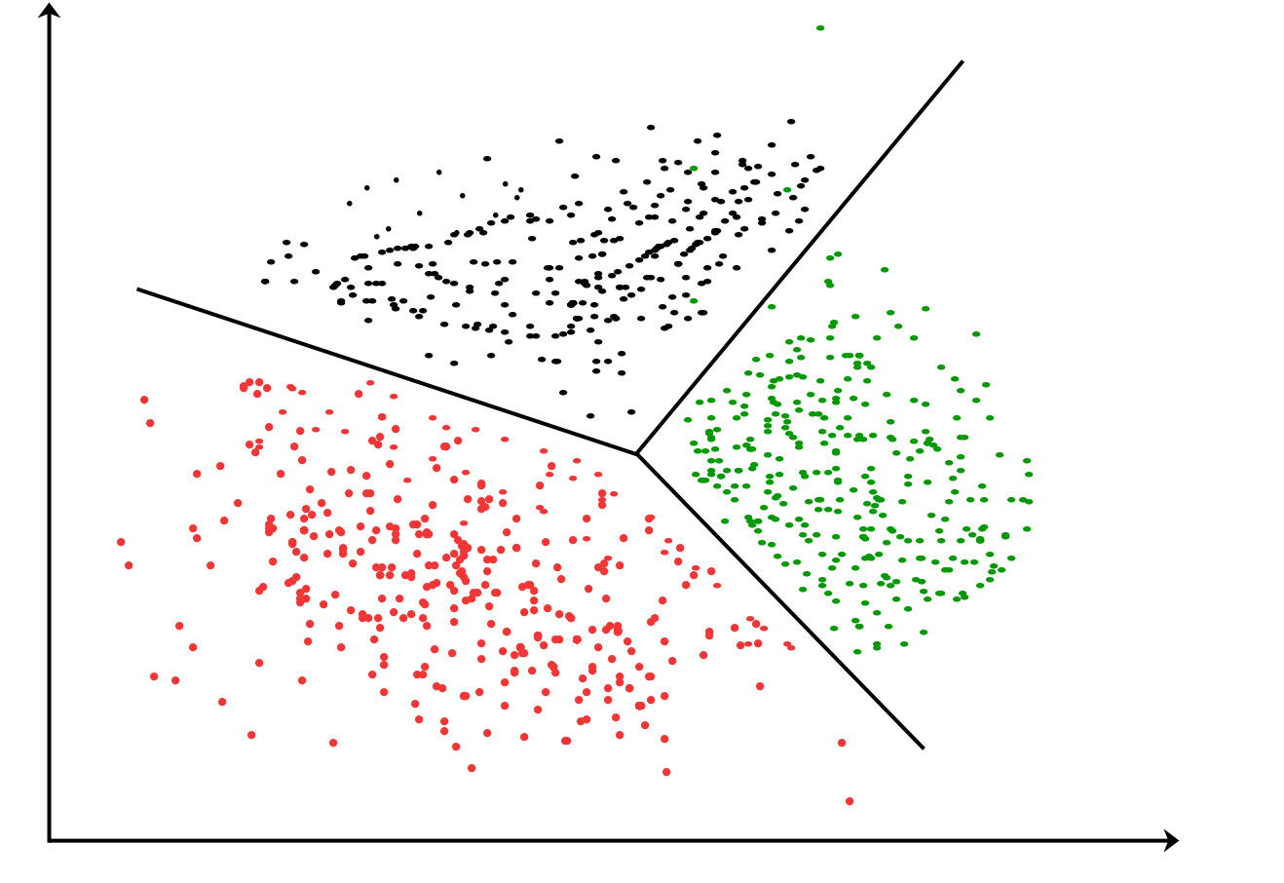
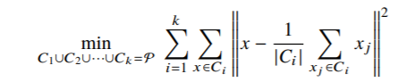

Performing Clustering
Finite set P = { x1, x2, …… xn }
$x_{i}=$(x, y)
P represents a finite set consisting of coordinates of the citizens which have requested for help
k: represents the number of groups we want to divide the set P into. (number of auth centers)
Euclidean distance between 2 points: ${\left\|x_{i} −x_{j}\right\|}^{2}$
k partitions are given by $C_{i}$where i ranges from 1 to k
$C_{1}UC_{2}U⋯C_{k}=P$ where $C_{i}$ is a subset of P
K-Means aims at minimizing the following function
The first step of this project is to divide citizens into
groups, where each group will be looked after by an
auth center. Or basically assign some set of citizens
to each auth center based on x, y coordinates
Clustering is performed by using an algorithm named K-Means clustering.
K-Means : K-Means clustering is a method of vector quantization, originally from signal processing, that aims to partition n observations into k clusters in which each observation belongs to the cluster with the nearest mean (cluster centers or cluster centroid), serving as a prototype of the cluster.

Slide 8

K-Means algorithm and Python Code
Let X = {x1,x2,x3,……..,xn} be the set of data points and V = {v1,v2,…….,vc} be the set of centers.
1) Randomly select ‘c’ cluster centers.
2) Calculate the distance between each data point and cluster centers.
3) Assign the data point to the cluster center whose distance from the cluster center is minimum of all the cluster centers..
4) Recalculate the new cluster center by taking mean of every point in that cluster
5) Recalculate the distance between each data point and new obtained cluster centers.
6) If no data point was reassigned then stop, otherwise repeat from step 3)
After performing the clustering of citizens into k groups each group has a mathematically generated centroid which is shifted to the nearest auth center and that auth center is assigned all the citizens in that cluster group.
Advantages of K-Means Clustering
K-Means clustering is a much faster way for generating such clusters and will be much more efficient when the data is much bigger
K-Means generates exactly k groups and hence if there are k auth centers all of them will be utilized

Slide 9
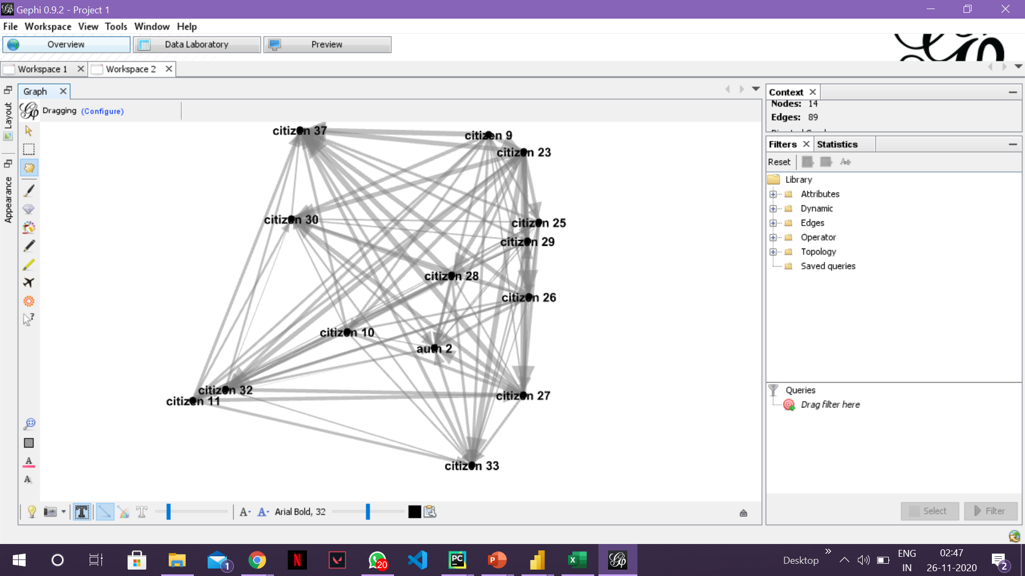
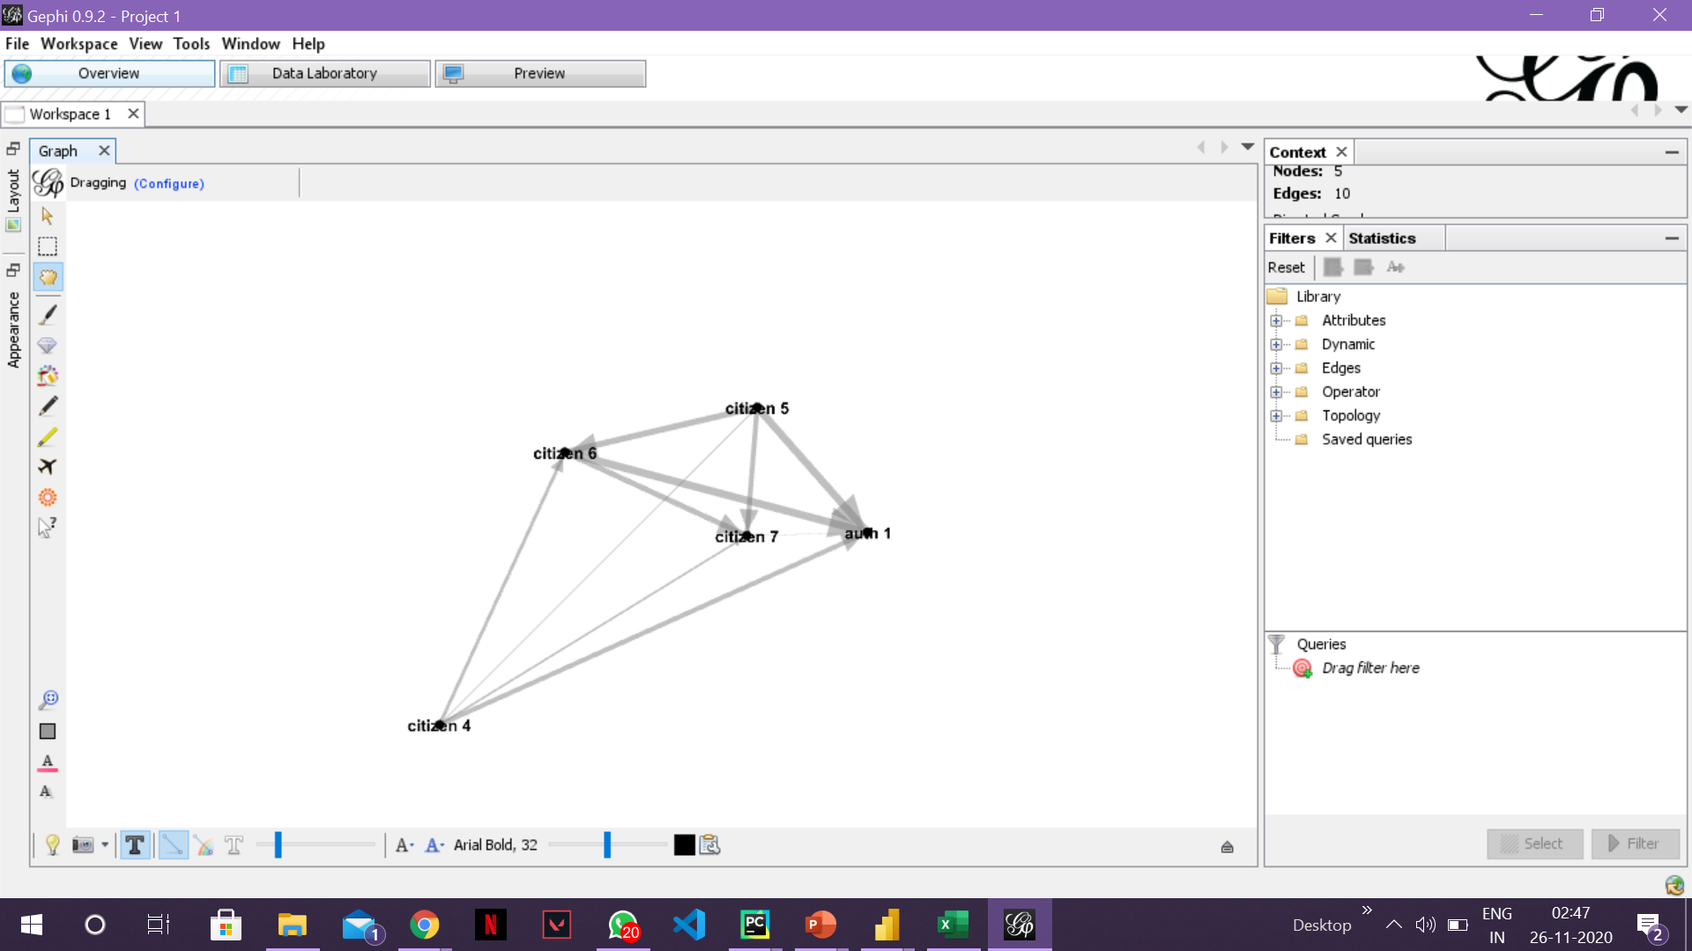

Clustering Results and creating graph
Lat | Long | identity | level | Cluster | Center Lat | Center Long | Auth Center
28.61419 | 77.07154 | citizen 1 | 1 | 3 | 28.6256914 | 77.10194107 | auth 6
28.67979 | 77.19491 | citizen 8 | 1 | 5 | 28.720002 | 77.220003 | auth 7
28.71745 | 77.15087 | citizen 7 | 1 | 8 | 28.7259717 | 77.162658 | auth 1
28.65952 | 77.20501 | citizen 28 | 1 | 2 | 28.6499765 | 77.2320588 | auth 2
28.60014 | 77.22649 | citizen 36 | 1 | 6 | 28.61609 | 77.243048 | auth 4
28.66916 | 77.31227 | citizen 41 | 1 | 4 | 28.6926703 | 77.28354435 | auth 3
28.57416 | 77.19537 | citizen 64 | 1 | 1 | 28.5735343 | 77.1863593 | auth 8
28.56366 | 77.28905 | citizen 53 | 1 | 0 | 28.5115704 | 77.3026233 | auth 5
28.54001 | 77.11978 | citizen 63 | 1 | 7 | 28.5012304 | 77.1823908 | auth 9
Clustering assigns auth center to every citizen and the table above gives an example of a citizen from every cluster. This data is used to create k weighted and connected graphs each representing a cluster.
Graphs of different clusters are not interconnected
$G_{i}: Graph for the i^{th}$ cluster, 1 $≤i ≤k$
$V_{i}: Vertices in the{ i}^{th }$graph
$V_{i}$ = All points $∈{ C}_{i}$set + {auth center}
Graph of every cluster now represents the auth center and its assigned citizens connected by various paths.
Graph made for Auth 1
Graph made for Auth 2

Slide 10
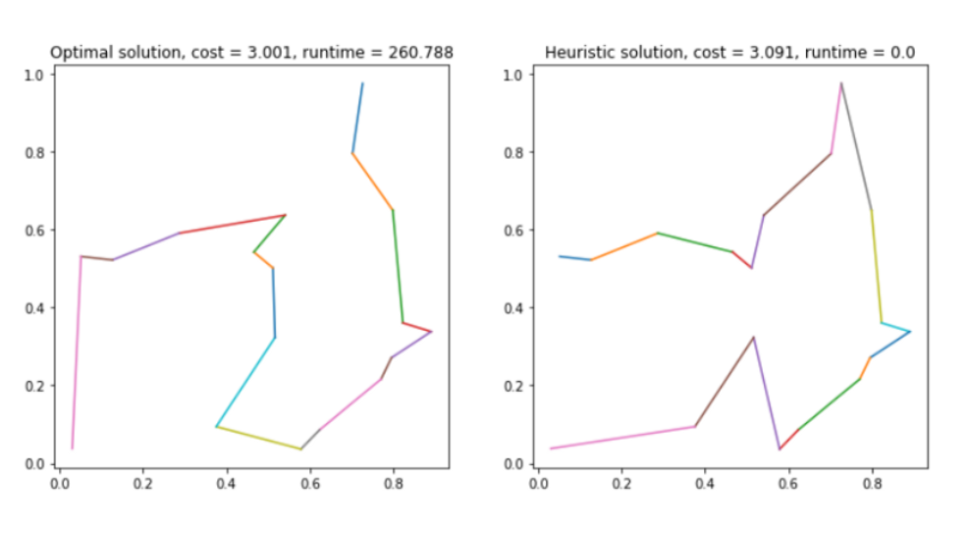
Applying TSP and finding the shortest Hamiltonian circuit
In previous step graphs for every auth center and its citizens are generated. The next motive is to find the shortest path a response team can take from the auth center, then extract/help every citizens they are assigned and return to the auth center.
To calculate the shortest Hamiltonian path we use heuristic approach of TSP instead of Dynamic Programming method
Dynamic Programming Method is more accurate, but TSP is an NP-Complete problem, and solving to optimality is highly unscalable particularly between increasing number of nodes in the graph. Hence, we use heuristic methods to compute TSP path between each citizen
Using heuristics and k different cluster graphs we compute a Hamiltonian circuit with the minimum cost.
TSP calculated for a random set of 17 cities
Runtime for DP is around 270 seconds whereas Heuristics take time in milliseconds, yet the cost of the graph is almost similar.

Slide 11
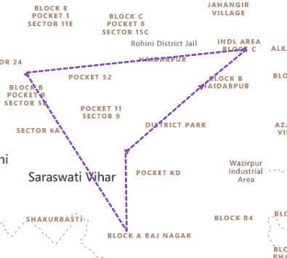
Heuristic Algorithm for TSP
Select a random edge and make a subtour of it.
Select a city not in the subtour, having the shortest distance to any one of the cities in the subtour.
Find an edge in the subtour such that the cost of inserting the selected city between the edge’s cities will be minimal.
Repeat step 2 until no more cities remain.
Repeat steps 1 – 4 for all edges in the graph and choose the minimum cost path
Steps 1 – 5 are repeated for all set of auth centre and their corresponding graphs
After applying TSP algorithm to one of the given graph

Slide 12
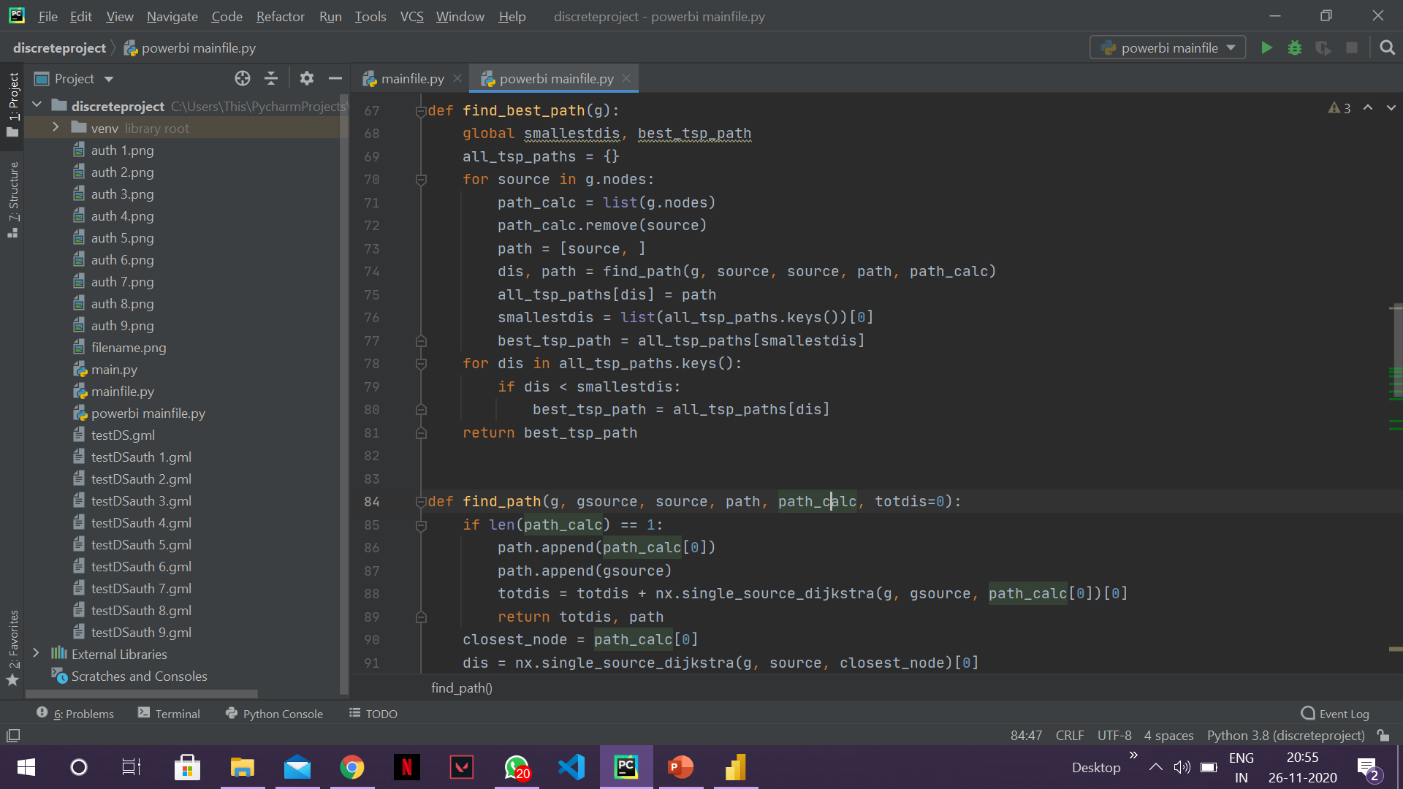
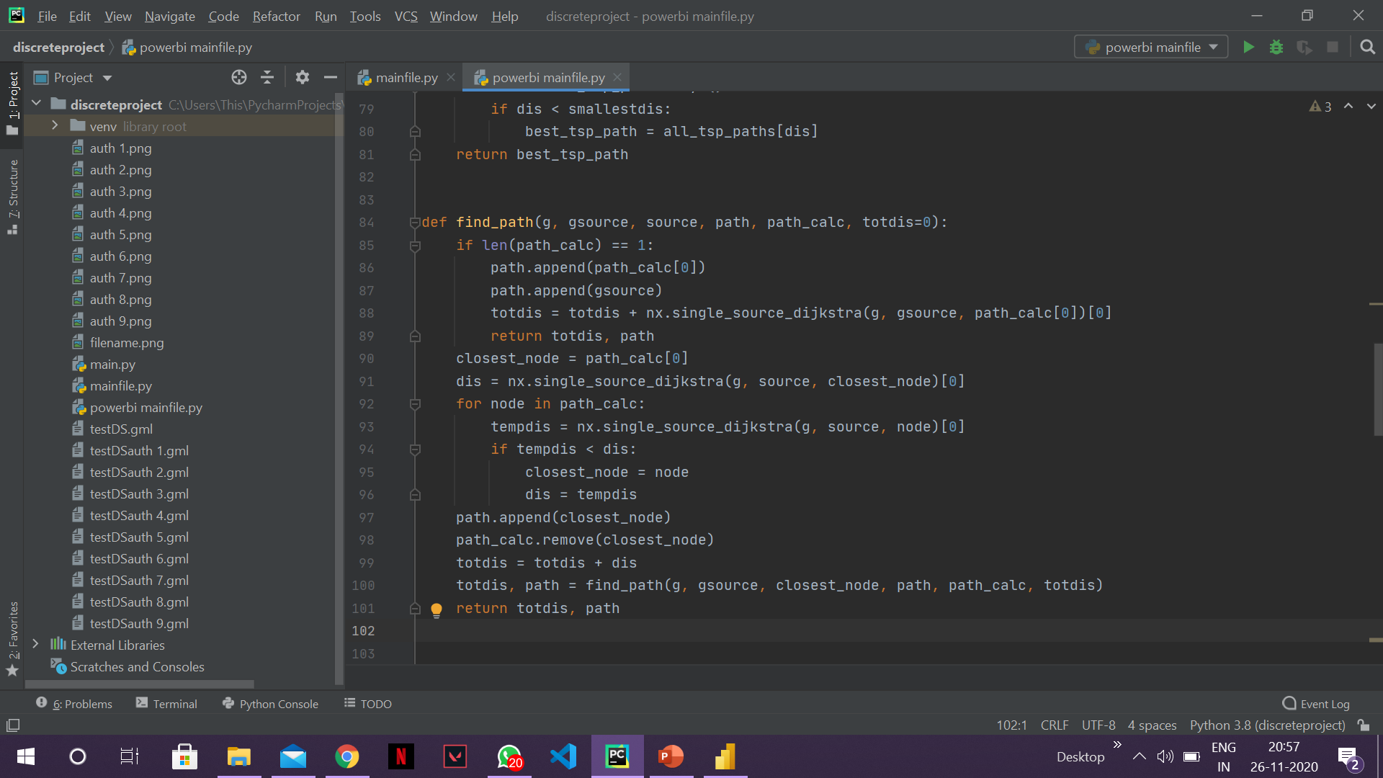
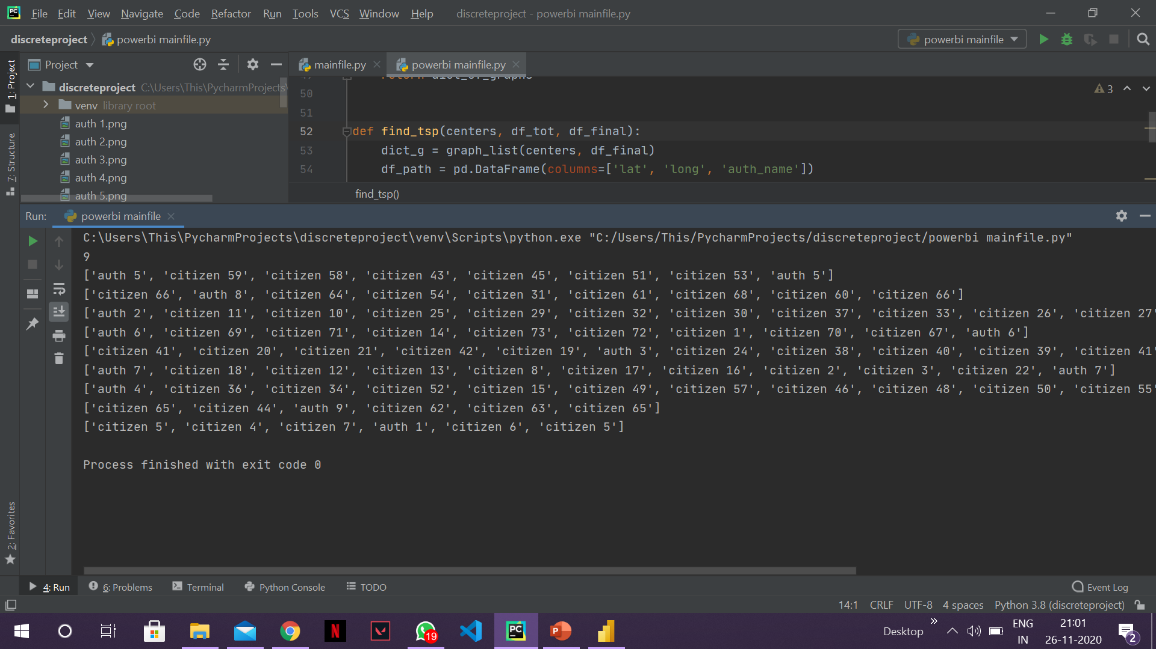
TSP path generated and the python code used
This data is then used to create a website where each auth center can access the citizens it needs to attend to and find the path it needs to take to extract everyone of them in emergencies and return back.
This project demonstrates how auth centers can efficiently manage the needy citizens as well as extract them efficiently during desperate times. To demonstrate this, a sample data was taken but for practical purposes data for the auth centers and the citizens with request help will be gathered in real time which was beyond the scope of this project

Slide 13
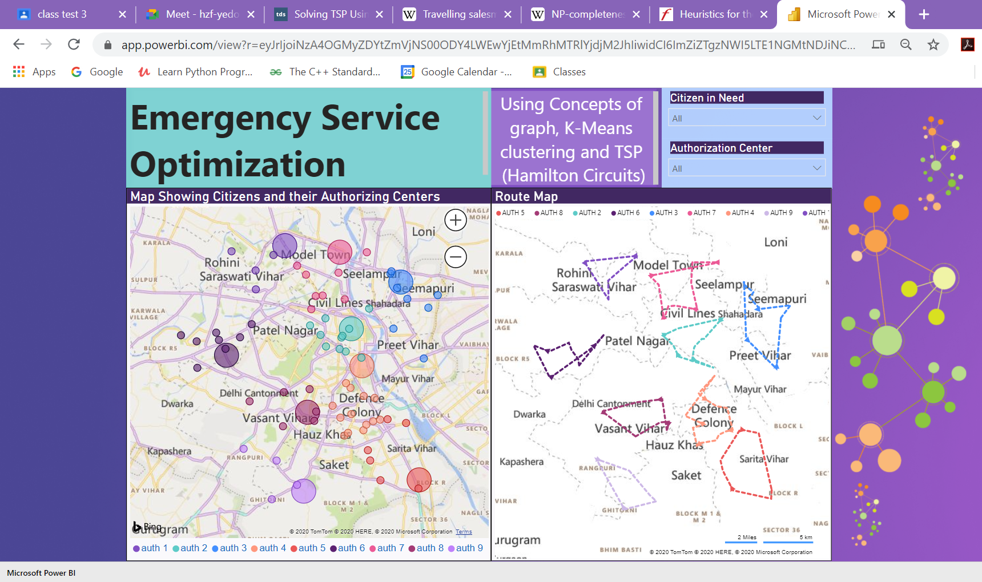
Webpage
This interactive webpage shows the clustering results as well as paths for every set of clusters

Slide 14

Conclusion
The world revolves around technology and the covid epidemic taught the world that it needs to be prepared for any such disasters in future. The concept demonstrated in this project can be used by various agencies or hospitals for providing maximum and quick help to needy citizens in desperate times.
With a team of coders developing an app which uses this project to make a portal for citizens where they can request extraction by any type of agency or by hospitals nearest to them and allow these agencies/hospitals to respond to needy citizens and help them without wasting time on planning the routes to take or which citizens to visit as that will be done by the program
Future Scope

Slide 15

THANK YOU!!

